Slide 1



Statistical Analysis and Learning (SAL): Classification (ISL Ch4, part 1) Textbook: An Introduction to Statistical Learning (ISL)
Varun Rai
LBJ School of Public Affairs
The University of Texas at Austin
14th February 2018

Slide 2
Note on Material
Unless otherwise noted, all material in this presentation are from this course’s textbook, An Introduction to Statistical Learning (ISL)

Slide 3
Classification: Logistic Regression
Notes:
Begin session 1

Slide 4
Classification: Working with Qualitative Response Variables
Quantitative vs. Qualitative response variables/Regression vs. Classification
In this unit (this and next class), learn: logistic regression; linear discriminant analysis, and KNN classification
In later units focus on more advanced methods such as trees, random forests, boosting, and support vector machines.

Slide 5
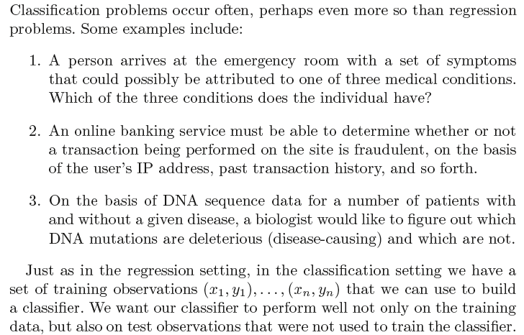
Overview of Classification

Slide 6
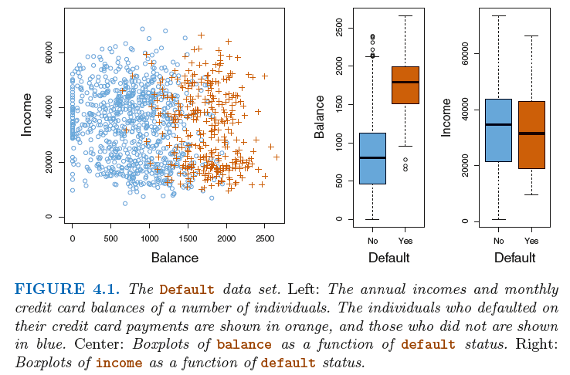
Example Problem: Credit Default Dataset

Slide 7
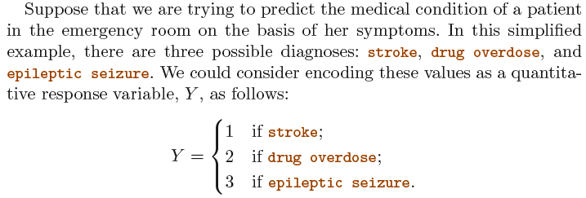
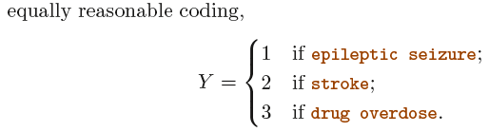
Why Not Linear Regression?

Slide 8
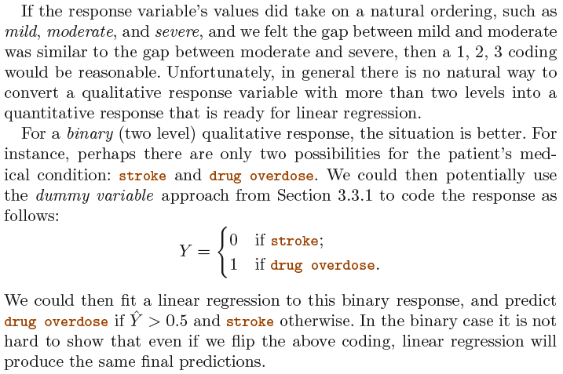
Why Not Linear Regression?...cntd

Slide 9
Why Not Linear Regression?...cntd
Notes:
Natural ordering and negative estimates?

Slide 10
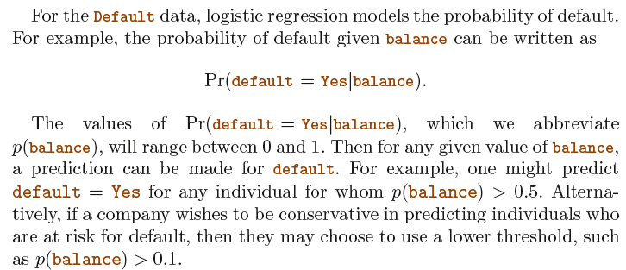
Logistic Regression

Slide 11
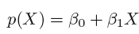
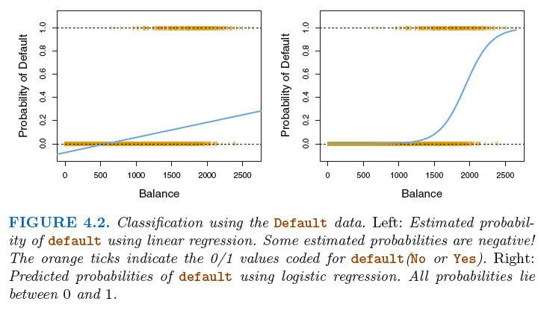
Logistic Regression: What If...

Slide 12
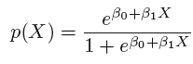
The Logistic Function

Slide 13
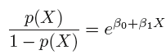
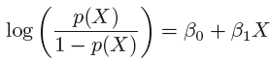
Odds and Log-Odds (Logit)
Odds:
Log-Odds:
Notes:
What is log-odds? Interpreting logistic regression?

Slide 14
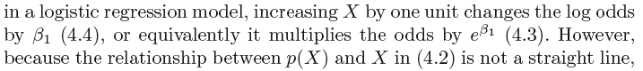
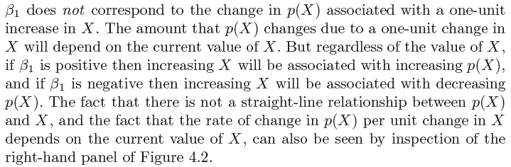
Interpreting the Coefficient in Logistic Regression
Notes:
End session 1

Slide 15
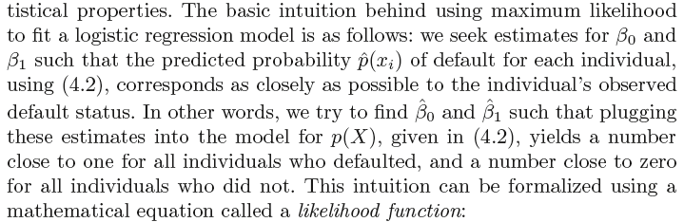
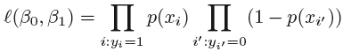
Estimating the Regression Coefficients: The Maximum Likelihood Method
Notes:
Begin session 2

Slide 16
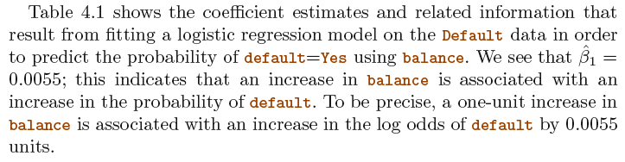
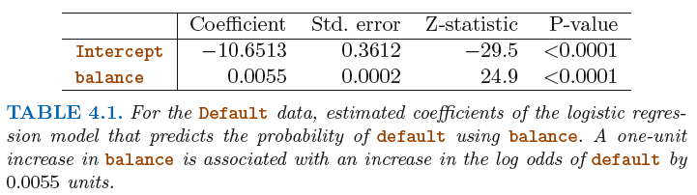
Estimating the Regression Coefficients

Slide 17
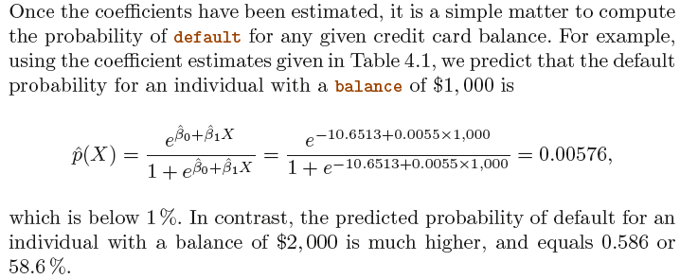
Making Predictions: Quantitative IV

Slide 18
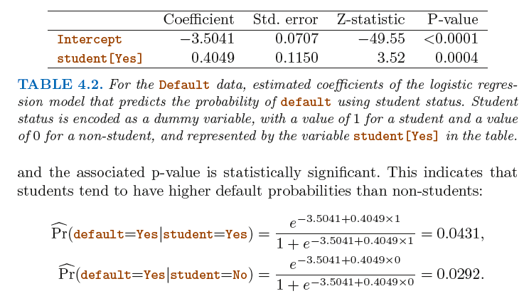
Making Predictions: Qualitative IV

Slide 19
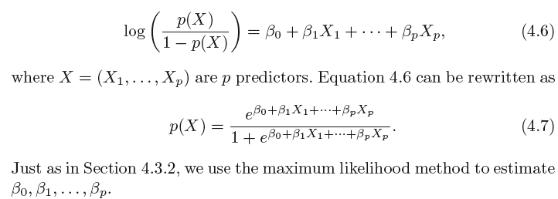
Multiple Logistic Regression, Binary Response

Slide 20
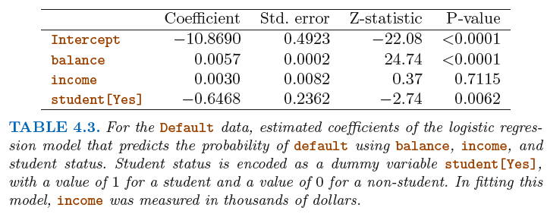
Multiple Logistic Regression, Binary Response
The coefficient for the (student) dummy variable is negative, indicating that students are less likely to default than nonstudents. In contrast, the coefficient for the dummy variable is positive in Table 4.2. How is it possible for student status to be associated with an increase in probability of default in Table 4.2 and a decrease in probability of default in Table 4.3?

Slide 21
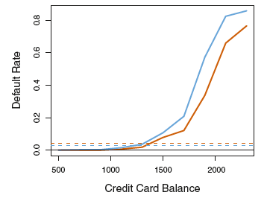
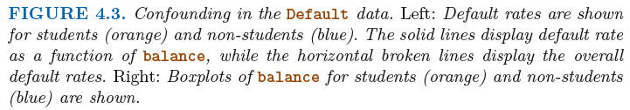
Multiple Logistic Regression, Binary Response

Slide 22
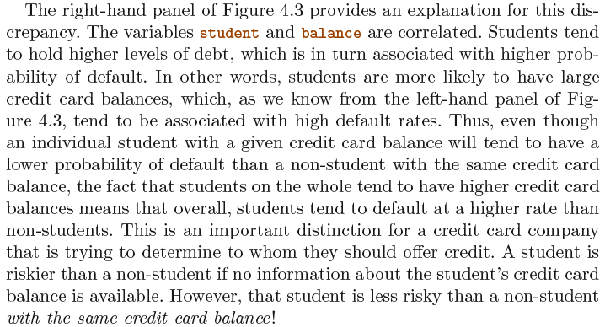
Multiple Logistic Regression, Binary Response

Slide 23
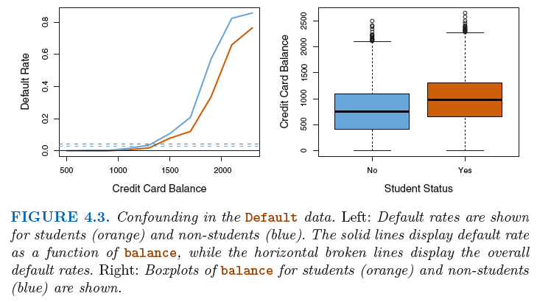
Multiple Logistic Regression: Confounding

Slide 24
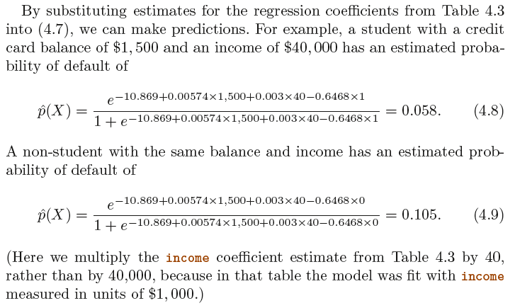
Multiple Logistic Regression: Prediction

Slide 25
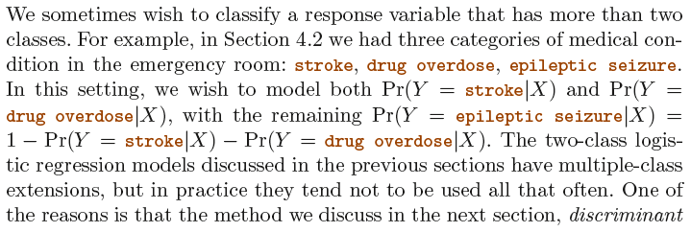
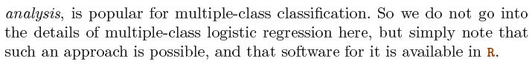
Logistic Regression with >2 Response Classes
Notes:
End session 2

Slide 26
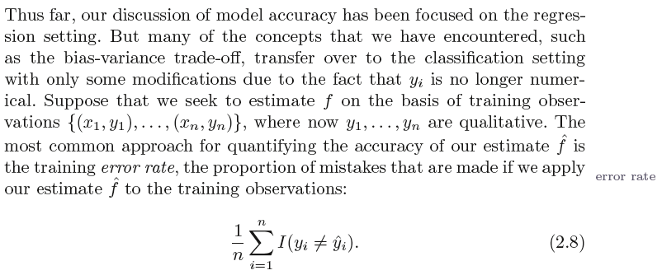
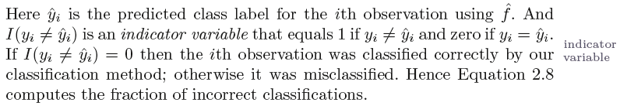
Error in the Classification Setting
Notes:
Begin session 3

Slide 27
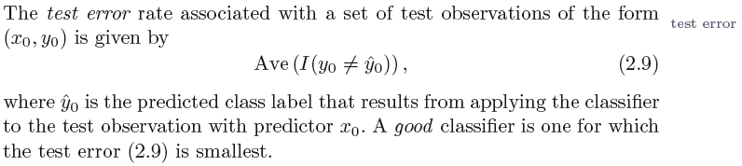
Error in the Classification Setting: Test Error
How would you calculate the test error?

Slide 28
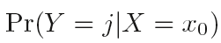
Bayes Classifier
The test error rate given in (Eq. 2.9) is minimized, on average, by a very simple classifier that assigns each observation to the most likely class, given its predictor values. In other words, we should simply assign a test observation with predictor vector x₀ to the class j for which the following probability is the largest:
Note that the Equation above is a conditional probability: it is the probability that Y = j , given the observed predictor vector x₀ . This very simple classifier is called the Bayes classifier .

Slide 29
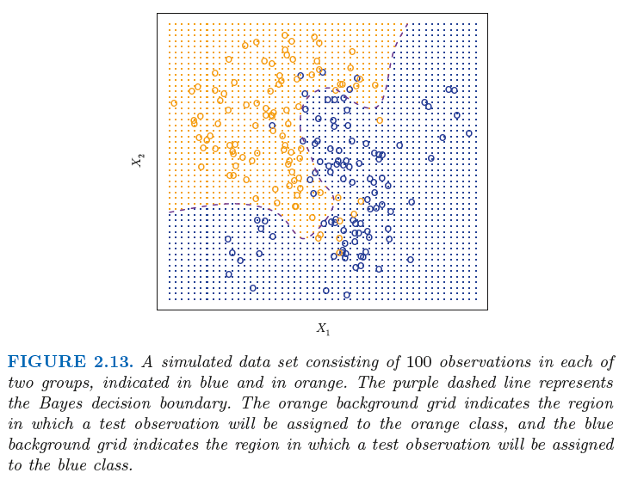
Bayes Classifier: Two-Class Example
Bayes Decision Boundary
Bayes Error Rate:
Test error rate of the Bayes classifier; It is greater than
zero, because the classes overlap in the true population.
Notes:
Bayes error rate: For our simulated data, the Bayes error rate is 0. 1304.

Slide 30
K Nearest Neighbor (KNN) Review
Notes:
Begin session 3

Slide 31
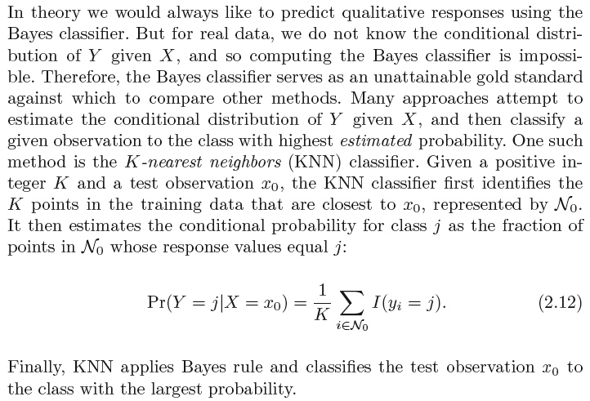
K-Nearest Neighbors (KNN) Classifier

Slide 32
K-Nearest Neighbors (KNN) Classifier

Slide 33
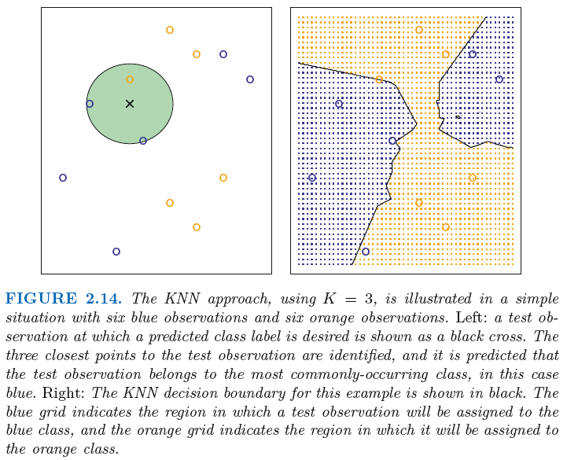
KNN Example

Slide 34
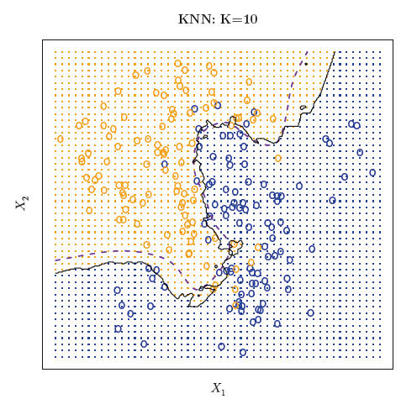
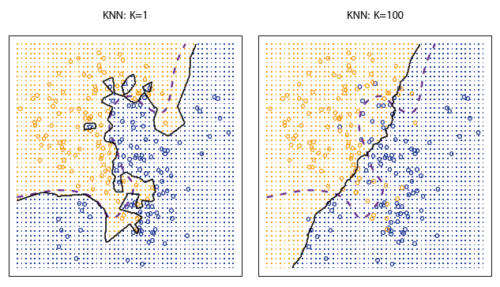
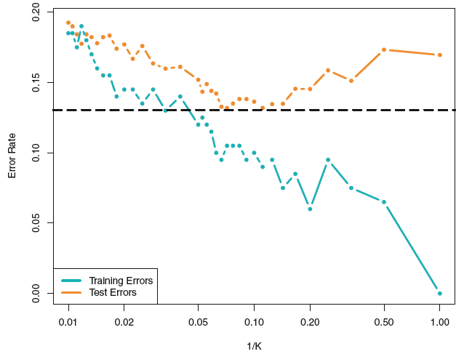
K-Nearest Neighbors (KNN) Classifier

Slide 35
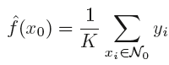
KNN Regression

Slide 36
KNN Regression
What would be the mean square error plots for these figures?
Notes:
LEFT: The same data set shown in Figure 3.17 is investigated further.
Left: The blue dashed line is the least squares fit to the data. Since f(X) is in
fact linear (displayed as the black line), the least squares regression line provides
a very good estimate of f(X). Right: The dashed horizontal line represents the
least squares test set MSE, while the green solid line corresponds to the MSE
for KNN as a function of 1/K (on the log scale). Linear regression achieves a
lower test MSE than does KNN regression, since f(X) is in fact linear. For KNN
regression, the best results occur with a very large value of K, corresponding to a
small value of 1/K.
RIGHT TWO: Top Left: In a setting with a slightly non-linear relationship
between X and Y (solid black line), the KNN fits with K = 1 (blue) and K = 9
(red) are displayed. Top Right: For the slightly non-linear data, the test set MSE
for least squares regression (horizontal black) and KNN with various values of
1/K (green) are displayed. Bottom Left and Bottom Right: As in the top panel,
but with a strongly non-linear relationship between X and Y .

Slide 37
KNN Regression
Notes:
LEFT: The same data set shown in Figure 3.17 is investigated further.
Left: The blue dashed line is the least squares fit to the data. Since f(X) is in
fact linear (displayed as the black line), the least squares regression line provides
a very good estimate of f(X). Right: The dashed horizontal line represents the
least squares test set MSE, while the green solid line corresponds to the MSE
for KNN as a function of 1/K (on the log scale). Linear regression achieves a
lower test MSE than does KNN regression, since f(X) is in fact linear. For KNN
regression, the best results occur with a very large value of K, corresponding to a
small value of 1/K.
RIGHT TWO: Top Left: In a setting with a slightly non-linear relationship
between X and Y (solid black line), the KNN fits with K = 1 (blue) and K = 9
(red) are displayed. Top Right: For the slightly non-linear data, the test set MSE
for least squares regression (horizontal black) and KNN with various values of
1/K (green) are displayed. Bottom Left and Bottom Right: As in the top panel,
but with a strongly non-linear relationship between X and Y .

Slide 38
KNN Regression: Curse of Dimensionality

Slide 39
Key Concepts
Logistic regression
Confounding
Maximum likelihood
KNN
Curse of dimensionality
Bayes Error rate

Slide 40
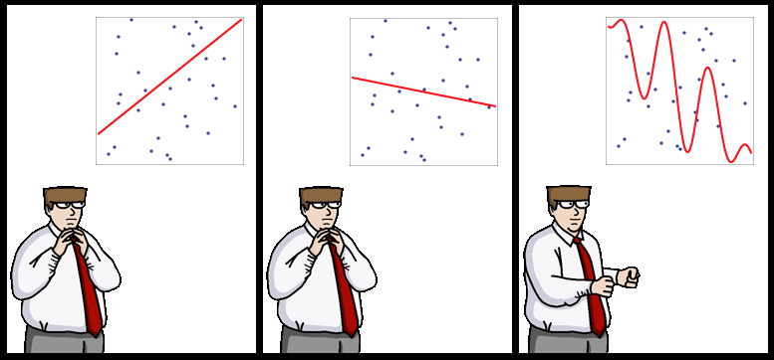
End of Lecture #5
Source: http://yaroslavvb.blogspot.com/

